Slide 1
Sentiment Analysis using the LSTM model and Flask web app
Presenter:
Vishakha Ramteke

Slide 2
Agenda
What is Sentiment Analysis
How to develop a Sentiment Analysis application
LSTM (Long Short-Term Memory)
What is Flask
Tokenization
Word Embedding
LSTM Code
ATOM Editor
FLASK Code

Slide 3
What is Sentiment Analysis
Contextual mining of text to extract and identify subjective information.
Focuses on determining the sentiment of the text, whether it's positive or negative.
Techniques, such as LSTM (Long Short-Term Memory), are employed for this task.

Slide 4
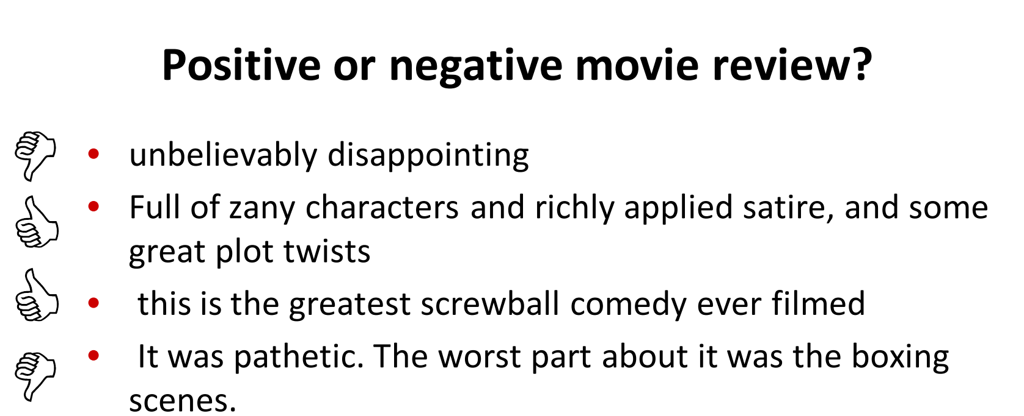

Slide 5
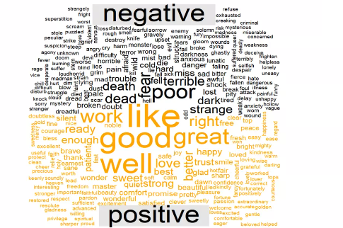
Fig 1. List of positive and negative words

Slide 6
How to develop a Sentiment Analysis application
LSTM (Backend)
Flask(Frontend)

Slide 7
LSTM (Long Short-Term Memory):
A type of recurrent neural network (RNN) architecture.
Efficient for analyzing sequential data like text due to its ability to retain long-term dependencies.
Efficient handling of vanishing gradient problem

Slide 8
What is Flask
Python-based
Open-source
Minimal dependencies
Lightweight Micro-framework
Third-party plugins
Flexibility

Slide 9
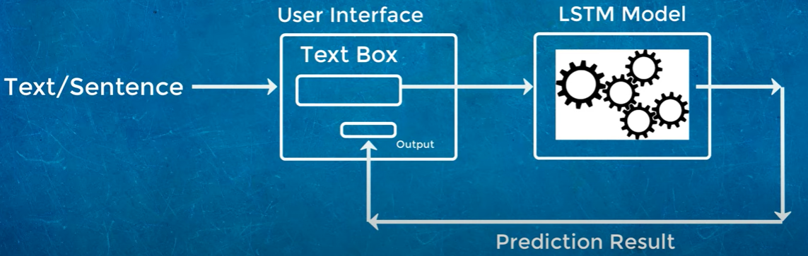
Fig 2.Web UI and LSTM Model Interaction Flow Diagram

Slide 10
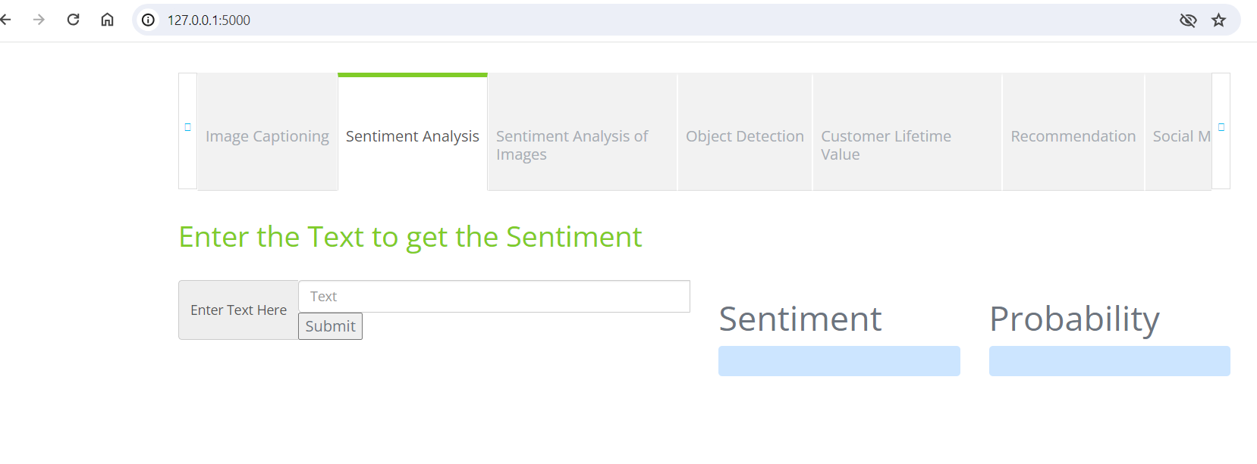
Web application overview

Slide 11
Keras IMDb Dataset:
The IMDb dataset provided by Keras is preprocessed and packaged as part of the Keras library.

Slide 12
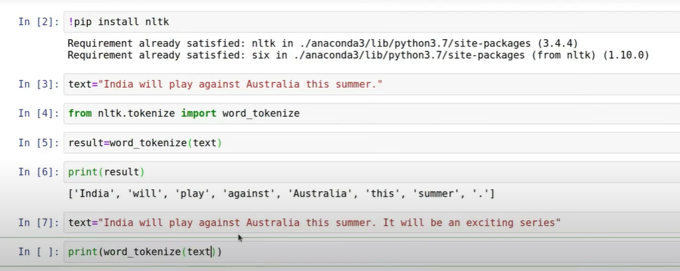
Tokenization
Breaks text into smaller pieces called tokens, like words or sub words.

Slide 13
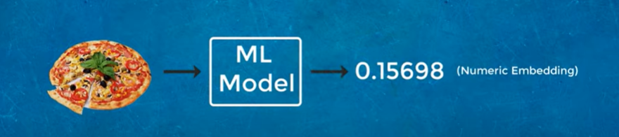
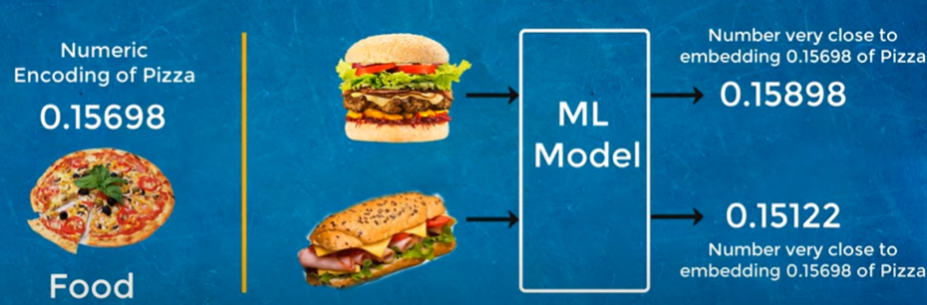
Word Embedding
Representation of words in Numeric form.
Understands the relationship between different words in a sentence or a document.

Slide 14
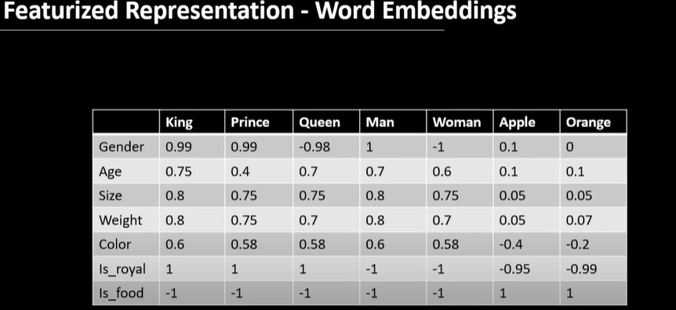

Slide 15

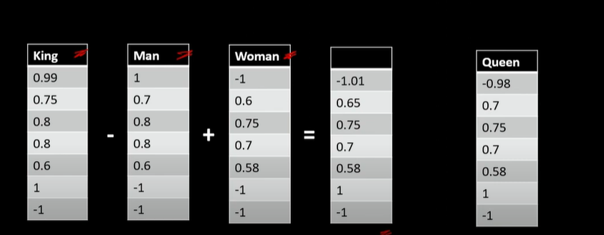

Slide 16
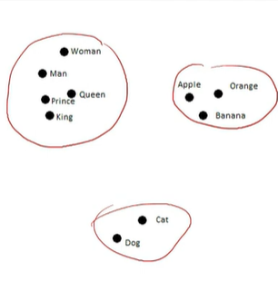

Slide 17
Two popular algorithms of Word Embedding
1)Word2Vec
-Continuous Bag of Words(CBOW)
-Skipgram
2)GloVe(Global vectors for Word Representation)

Slide 18
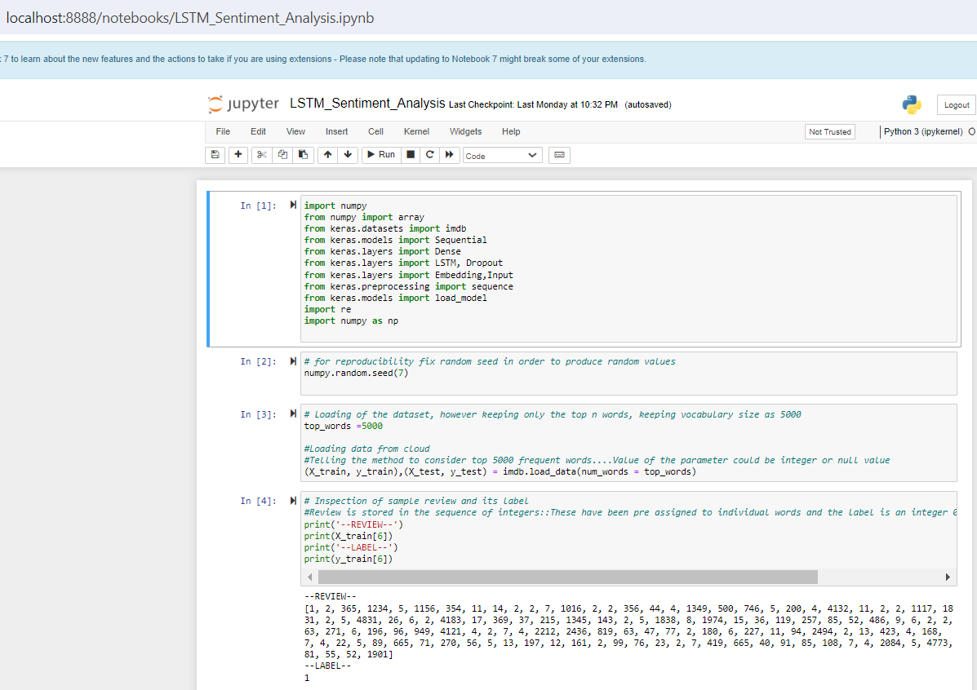
LSTM Code

Slide 19
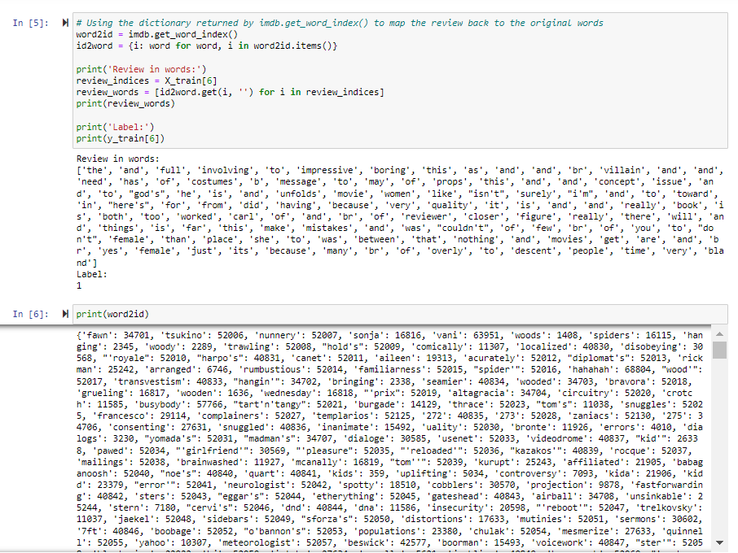

Slide 20
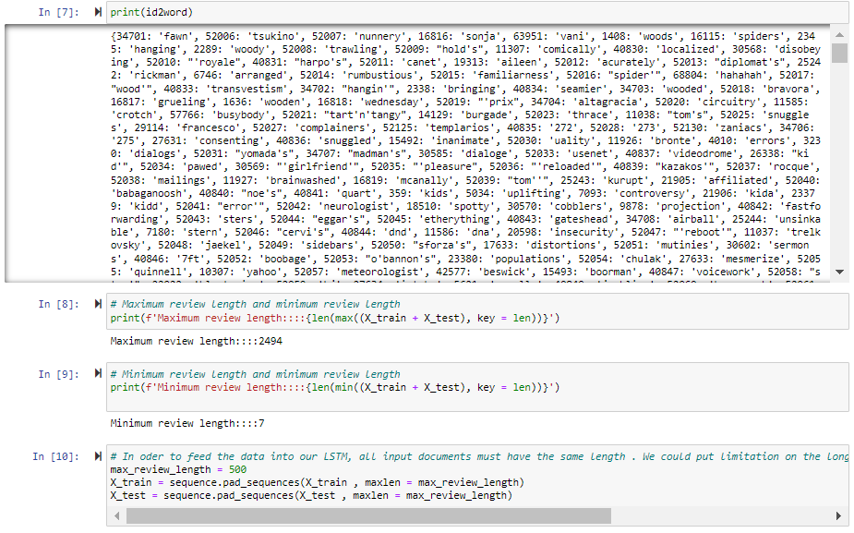

Slide 21
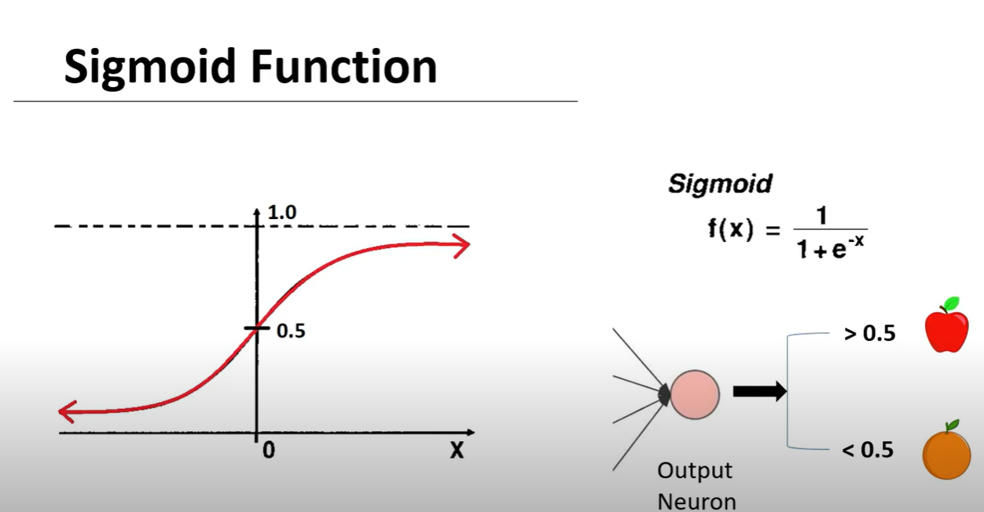

Slide 22
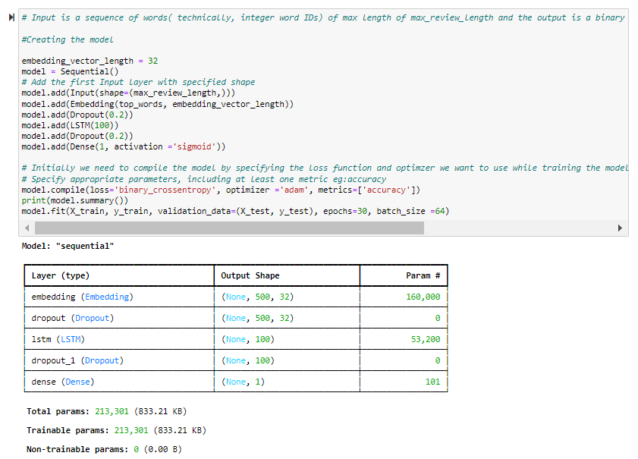

Slide 23
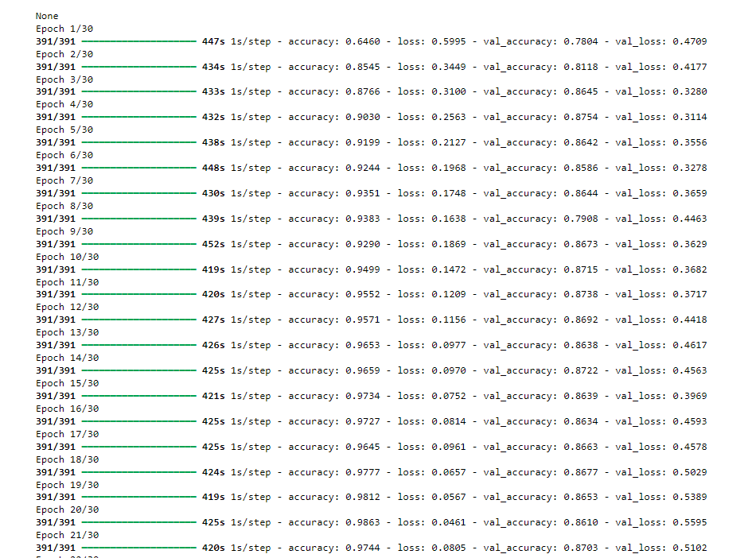
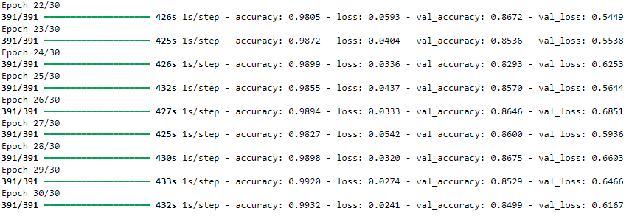

Slide 24
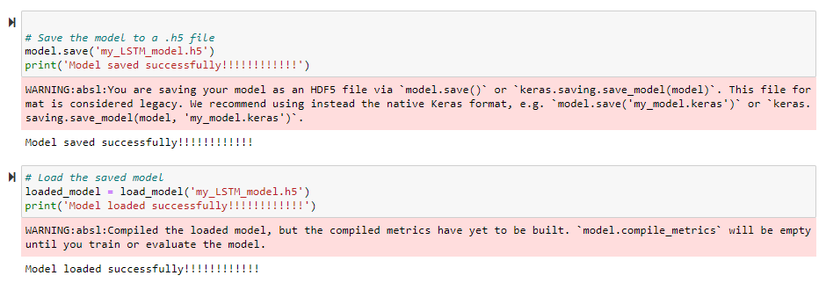

Slide 25
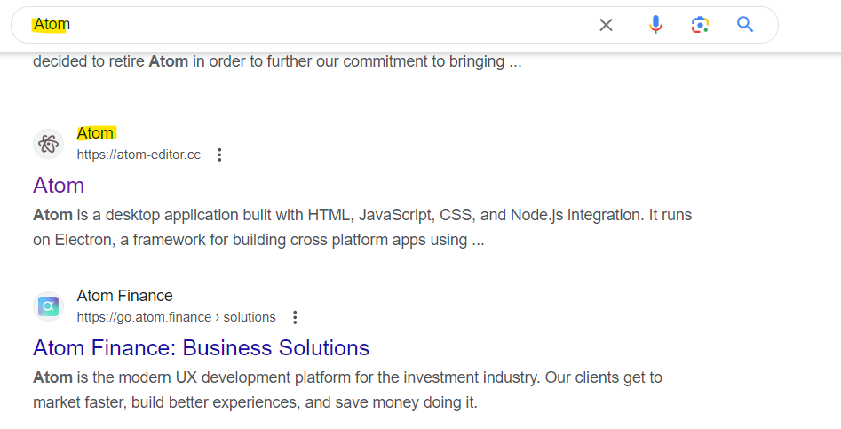
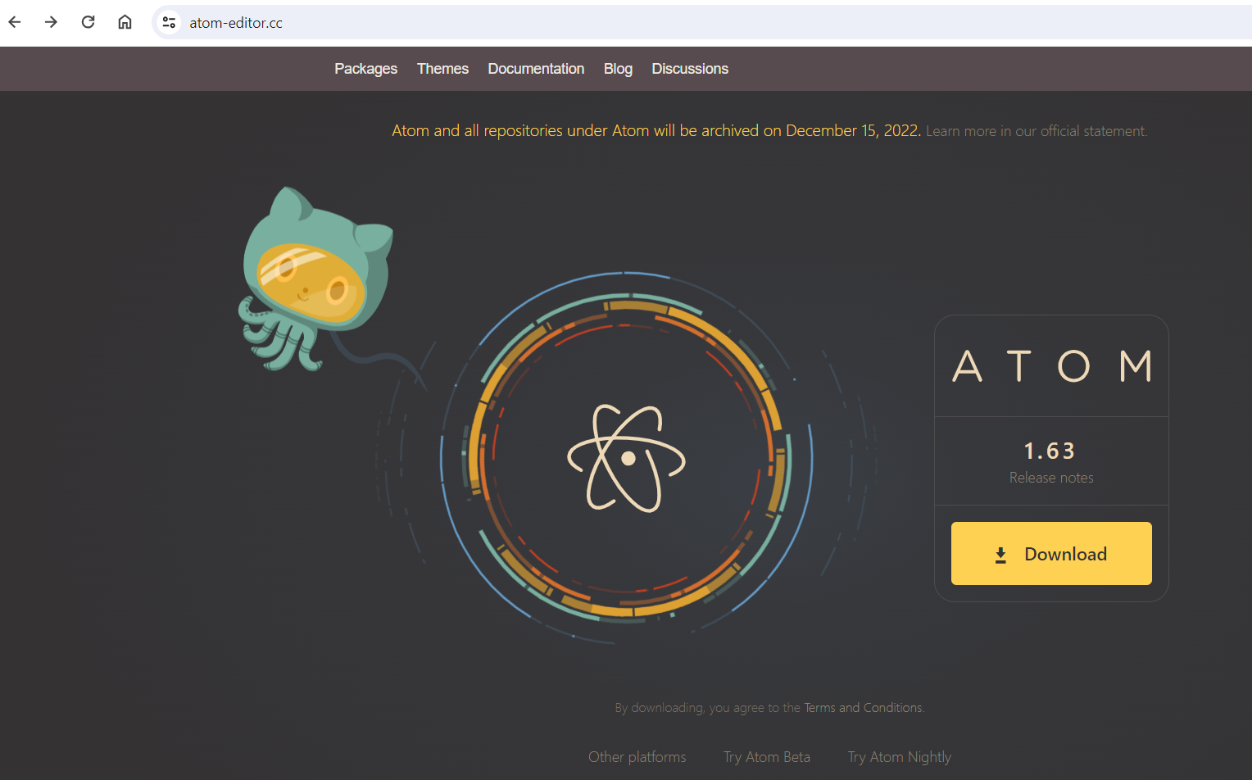

ATOM Editor
1)Type in Atom in the Google search bar and select
the highlighted Atom link
2) Click on the Download button.

Slide 26
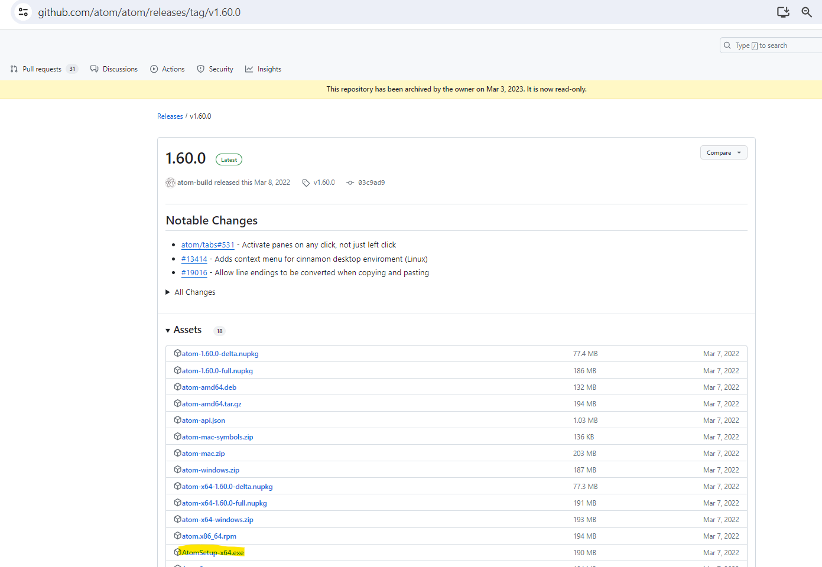
3) Click on the highlighted installer for Windows.

Slide 27

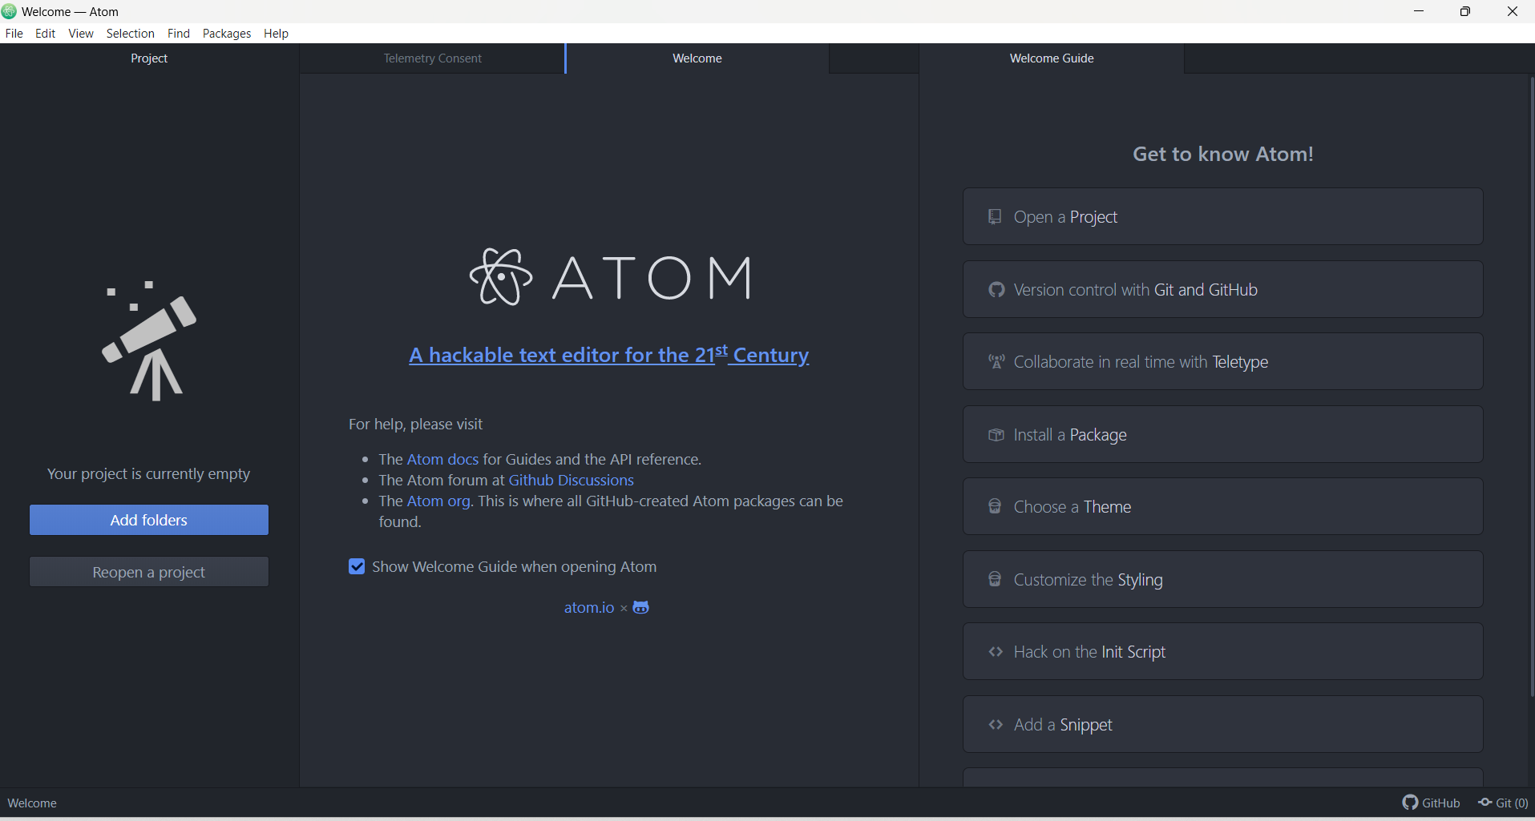
4) Installing ATOM
5) Welcome page of ATOM ,once it is successfully installed

Slide 28
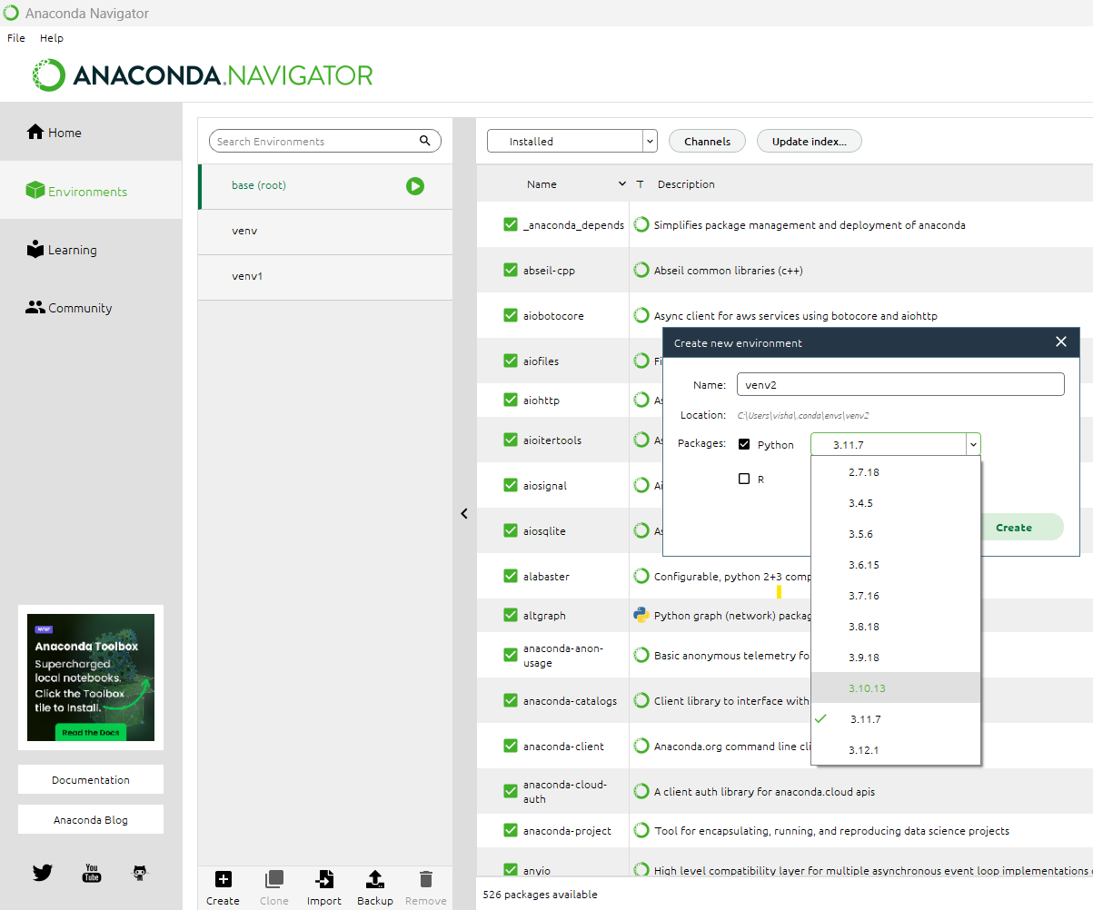
Ways to create a virtual environment
1)Through ANACONDA NAVIGATOR
Environments -> Create->Give environment name and select required python version-> Click on create button

Slide 29
2)Through Anaconda Prompt
a)Open Anaconda Command Prompt
b)Suppose you want to create a virtual environment with Python 3.10.13.
conda create --name your_env_name python=3.10.13
c)Activate the virtual environment.
conda activate your_env_name
Note: Make sure the virtual environment is activated before working on the Python code.
d)Deactivate the virtual environment, if done working with it.
conda deactivate

Slide 30
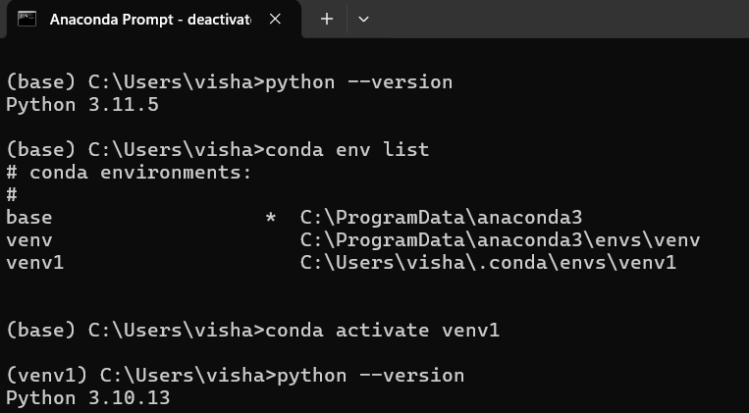
Checking base version and virtual environment details

Slide 31
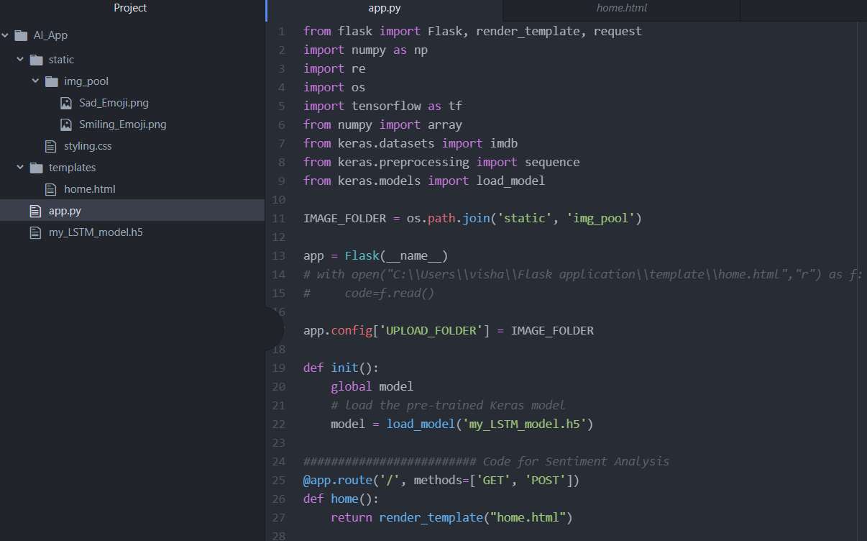
FLASK Code

Slide 32
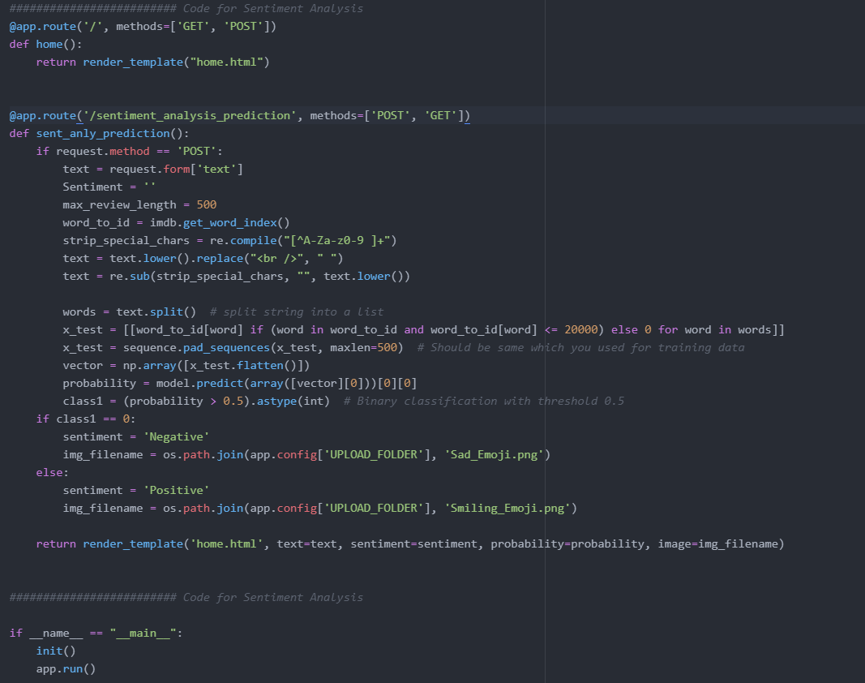

Slide 33
Building home.html
Textbox
Button
Probability score
Corresponding sentiment

Slide 34
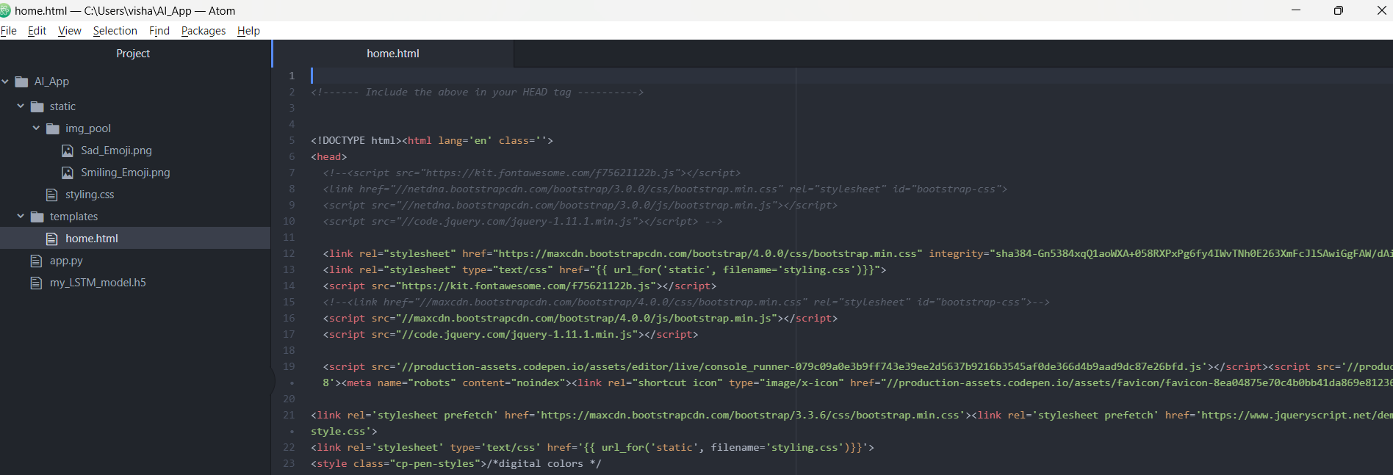

Slide 35
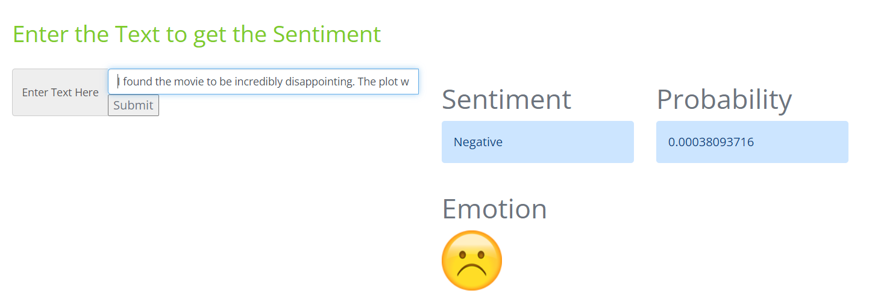
Output for Negative Sentiment
Input text: I found the movie to be incredibly disappointing. The plot was weak, the acting was subpar, and the ending was unsatisfying

Slide 36
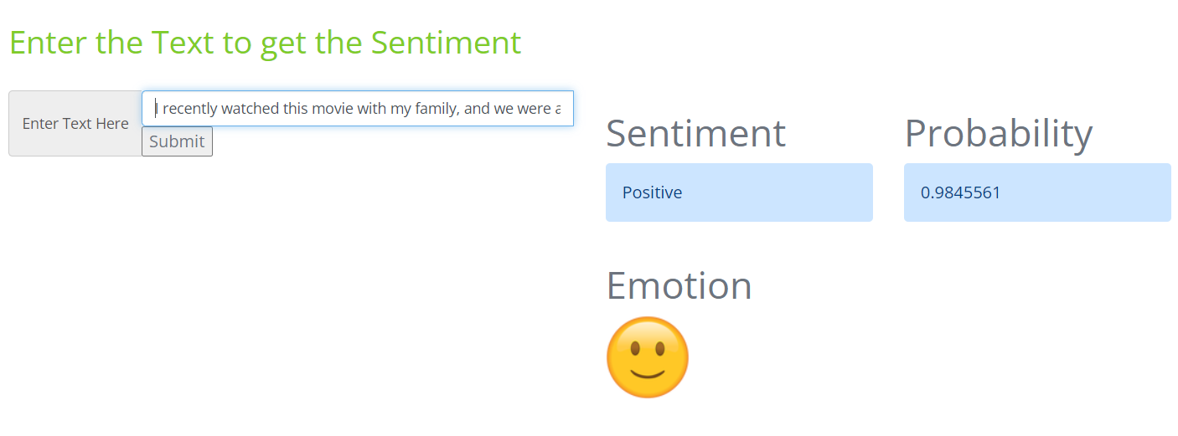
Output for Positive Sentiment
Input text: I recently watched this movie with my family, and we were all blown away by how entertaining it was! The storyline was engaging, the visuals were stunning, and the performances were top-notch. We laughed, we cried, and we left the theater feeling uplifted and inspired. It's definitely one of the best movies we've seen in a long time, and we can't wait to watch it again!"

Slide 37
THANK YOU!!!!!

Slide 38
References
https://www.youtube.com/watch?v=RqvYSY7deeA&list=PLECsJRrufNwd7LhsG-a28mKZvhoNGyldL
https://www.slideshare.net/ijtsrd/lstm-based-sentiment-analysis
https://www.youtube.com/watch?v=hZ5Xlc6PLfk
https://www.youtube.com/watch?v=nam2zR7p7Os&t=468s
https://www.youtube.com/watch?v=tT6OfLnum2w
https://www.youtube.com/watch?v=Y9qdKsOHRjA

